Slide 1
Super AWESOME MEGA GAME
Presentation by ELTOJO Studio

Slide 2
Introduction
Aim of the Project
Brief Description of the Project

Slide 3
Overview of the project proposal
Proposed Technical Approach
Requirements
Game Mechanics
Implementation
Quality Assurance Plan (ISO 9126)
Expected Project Results
Project Management
Schedule
Development Methodology

Slide 4
Background
Why Circular Maze?
Why Android Controller?
Why this type of Maze?
Why Puzzles?

Slide 5
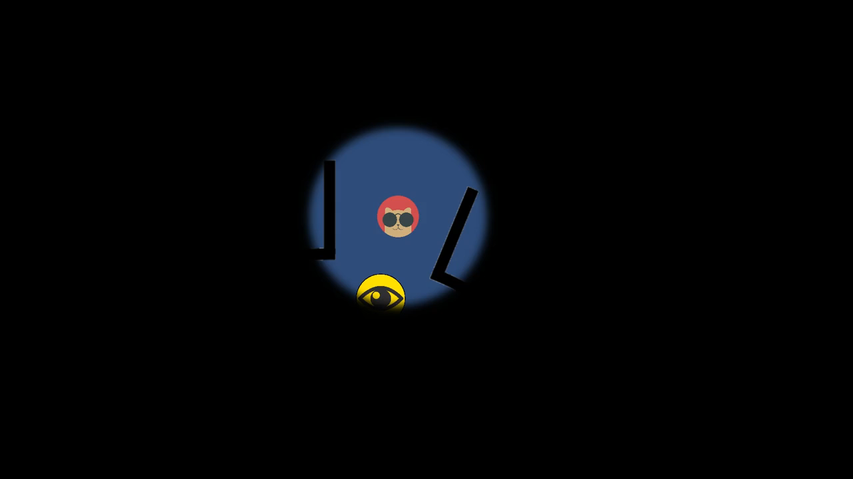
Prototype Demonstration

Slide 6
Technologies
Object Orientated Programming
SFML
Android
Sensors
Notes:
There are a few technologies that we’ll be using for the project, one of the main technologies is that of Object orientated programming with the c++ language, and with that, the SFML libraries. This is being used as we are learning this in the gaming module and this will tie in nicely to the project itself and provide us with a better understanding of game features and how best to implement them.
One of our main features is the android controller, we are hoping to create a connecting controller using the android operating system, and through that make use of the sensors in the device to enhance the gameplay. As a backup for this, a high end game controller also includes the sensors that we’re aiming to utilize.

Slide 7

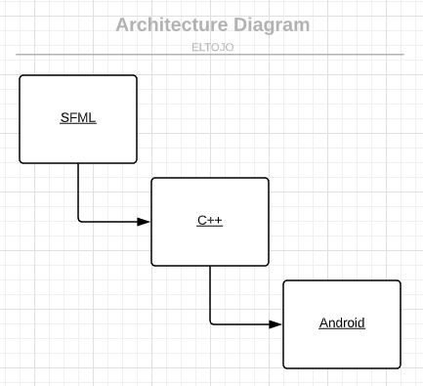
Architecture Diagram

Slide 8
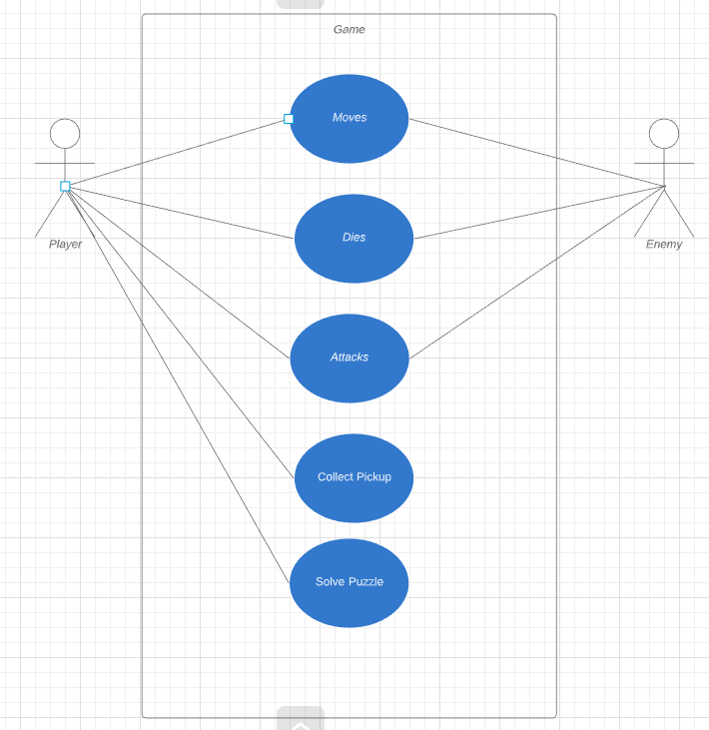
Use Case Diagram

Slide 9
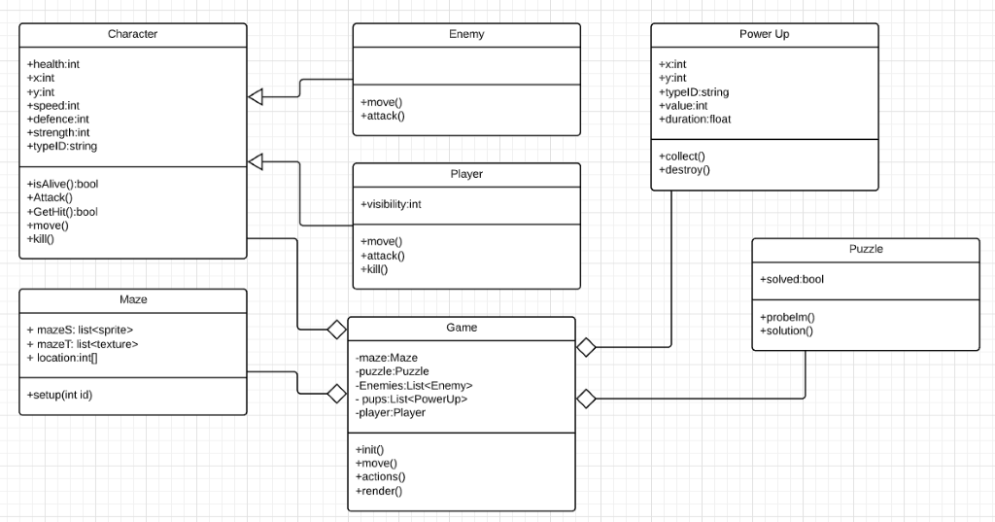
Class Diagrams

Slide 10
Team management
Agile
Weekly meetings
Gantt chart
Game feature chart

Slide 11
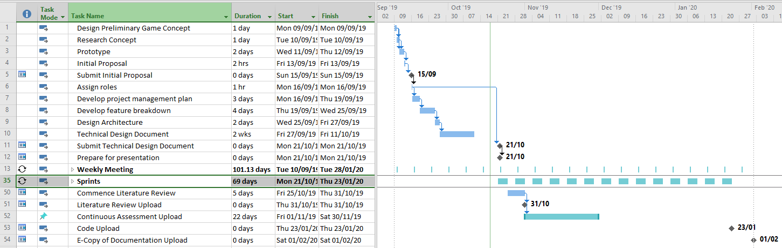
Gantt Chart

Slide 12
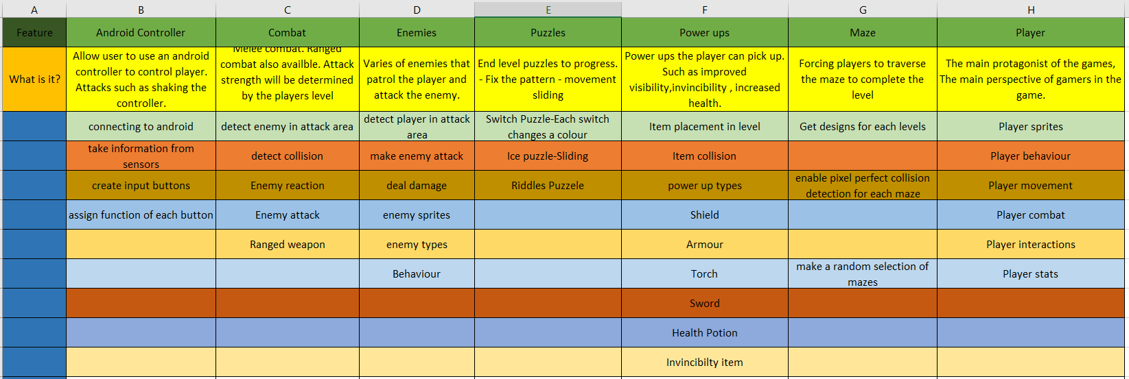
Game feature chart

Slide 13
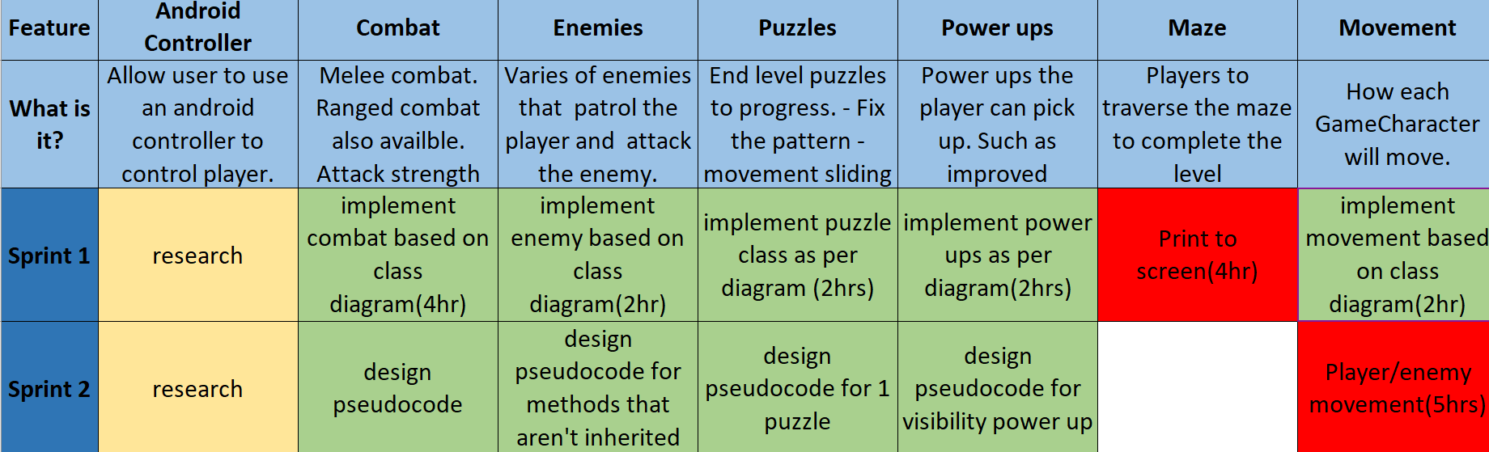
Sprints

Slide 14
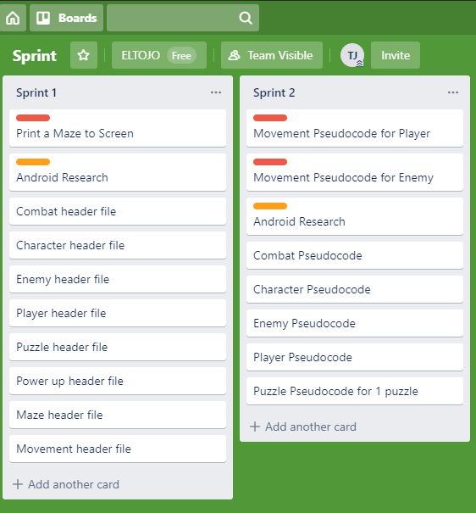
Trello Sprints

Slide 15

SUPER CUTE Puppy

Slide 16
Project management
GitHub
Discord
Trello
Slack

Slide 17

QUESTIONS?

